Slide 1

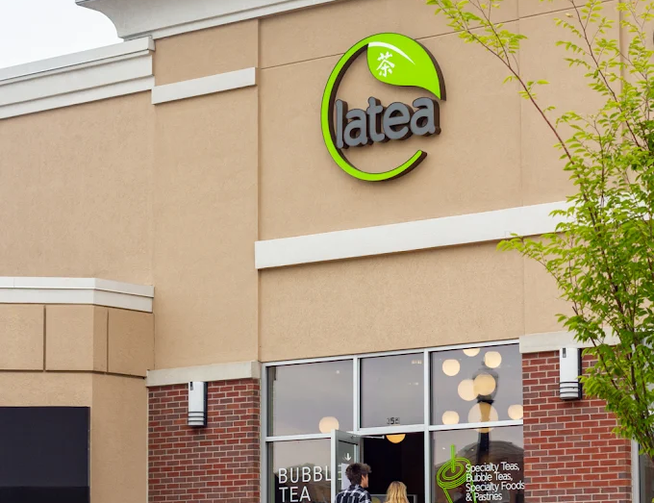

MGMT 5285: Consumer Behavior & Marketing
Brewing Connections:
A/B Testing Persuasion Strategies
Group #14

Slide 2

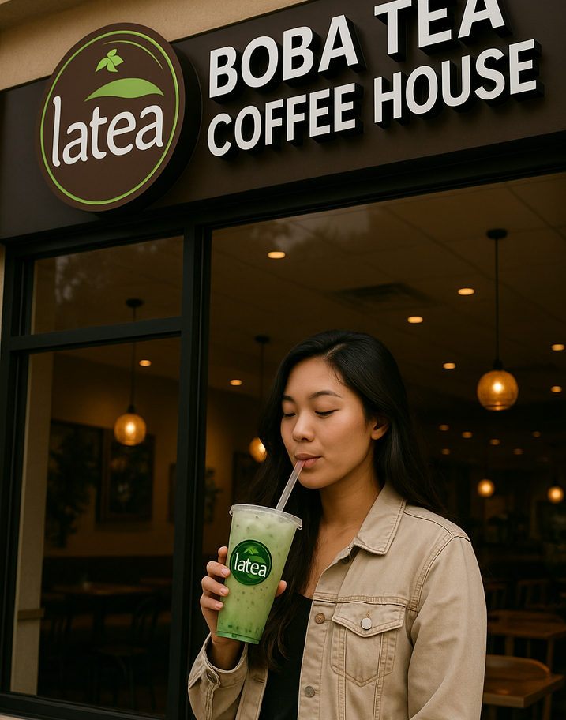




OVERVIEW
Latea Bubble Tea and Coffee, founded in 2013 by Jack Hsiao, offers premium, customizable tea and coffee drinks using organic, whole-leaf teas and fresh ingredients. With four U.S. locations, it emphasizes quality, authenticity, and a playful, community-driven experience that reflects modern consumer preferences.
Established | Branches | Customizations | Market Growth
Founded in 2013
4 U.S. Branches
10+ Options
USD 1.47B by 2030

Slide 3
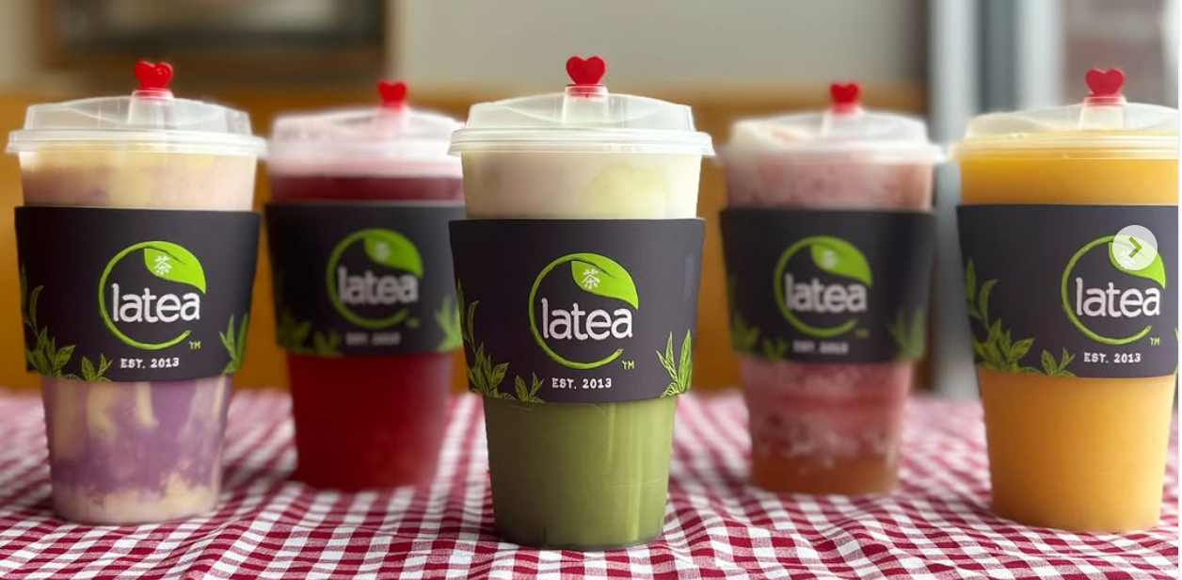






CAMPAIGN GOALS
(STRATEGIC ROADMAP)
Methodology
Compared two Instagram ad types: one focused on product quality (central route) and the other on emotional/social appeal (peripheral route).
Objective
Determine which ad strategy — emotional storytelling or product customization — most effectively drives engagement among Latea’s core audience using a controlled A/B test on Instagram.
Success Metrics
Reach, post interactions, website traffic, and profile visits were monitored to gauge campaign performance.

Slide 4



TARGET MARKET SEGMENTATION
(Target Audience Analysis)
Demographic
Pschycographic
Age - 18–34, college students and early career professionals.
Gender - Both genders, slight female skew.
Ethnicity - Diverse, including Asian American, Hispanic/Latinx, and African American.
Trend Sensitivity - Open to new trends and "Instagrammable" items.
Customization Oriented - Enjoy personalizing drinks to suit preferences and health needs.
Health Conscious - Prefer healthier, natural ingredient options.
Target
Segments
Geographic
Behavioral
West Lafayette, IN
Champaign, IL
Culver City, CA
Lone Tree, CO
Socially Connected - Share bubble tea experiences on social media, creating organic buzz.

Slide 5
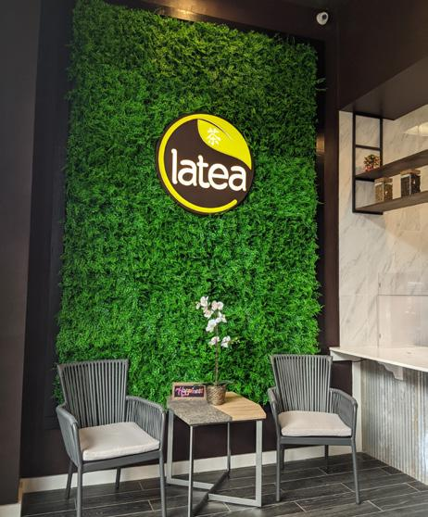
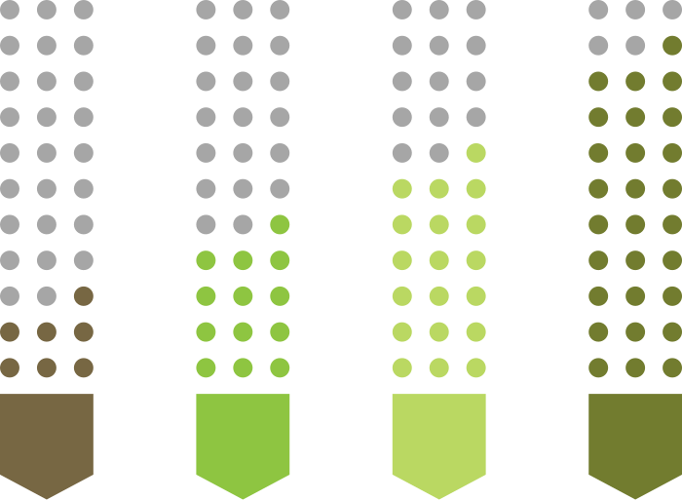
TARGET MARKET SEGMENTATION
(Target Audience Analysis)
Geographic
Behavioral
Demograhic
Phsychographic
[Magnitude and Relative Importance of each segmentation]

Slide 6
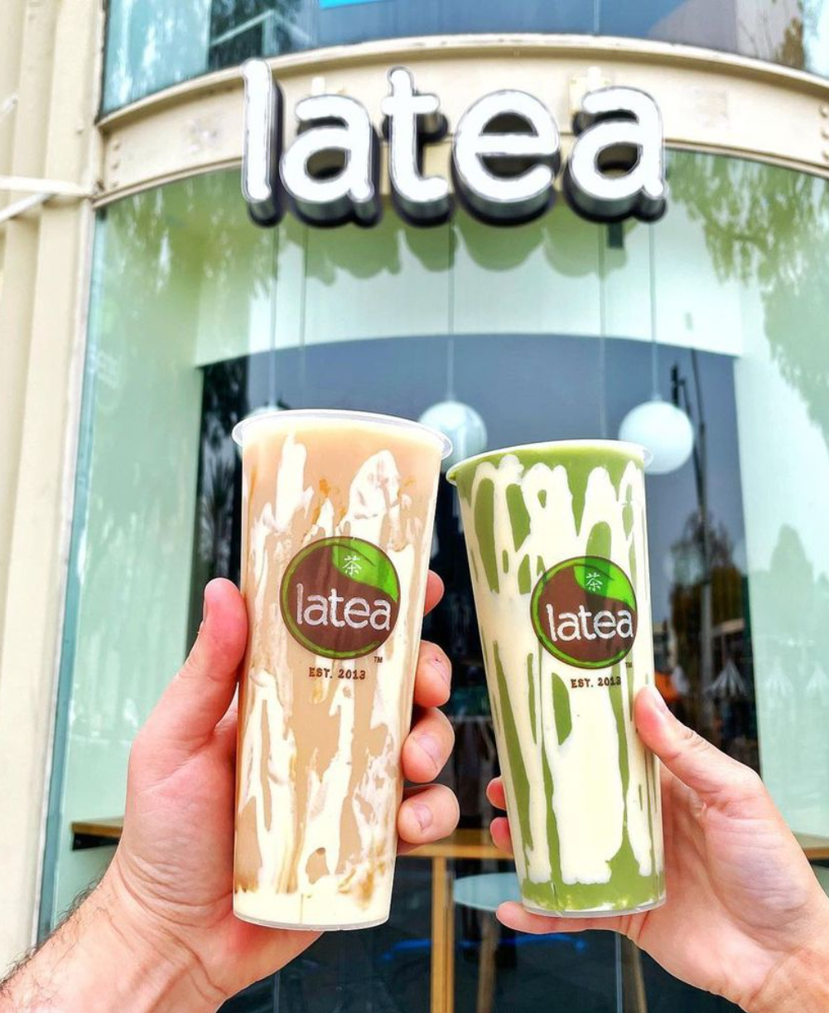




CONCEPTS AND HYPOTHESIS
(Applying Consumer Behavior Frameworks)
AD #1: CENTRAL ROUTE
AD #2: PERIPHERAL ROUTE
Based on Elaboration Likelihood Model (ELM) – Central Path: Appeals through logic, product info
Reinforces Self-Image Congruence: Aligns with consumers’ self-expression
Leverages ELM – Peripheral Path: Emotional, affective appeal
Uses Reference Group Influence: Friends enjoying Latea = social proof
Hypothesis: Ad 2 will outperform Ad 1 in social media engagement due to its emotional and social resonance

Slide 7
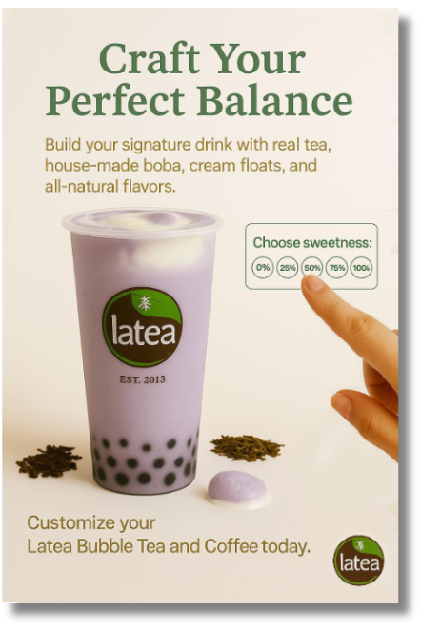






ADVERTISEMENT #1
(Central Route Persuasion)
HEADLINE
ELM
(CENTRAL)
“Craft Your Perfect Balance” highlights personalization and quality.
Uses detailed, rational messaging for thoughtful decision-makers.
DESIGN
CUSTOMIZATION
SELF IMAGE CONGRUENCE
Minimalist visual with focus on premium ingredients and customization.
Offers choice in sweetness levels and add-ons like boba and cream float.
Aligns product with consumers’ desire for authenticity and individuality.

Slide 8

ADVERTISEMENT #2
(Peripheral Route Persuasion)
TAGLINE
ELM
(PERIPHERAL)
“Bubbles in Your Cup. Bubbles in Your Heart.” emphasizes emotional and social moments.
Relies on emotional cues and social imagery to create positive brand associations.
DESIGN
REFERENCE GROUP INFLUENCE
HYPOTHESIS
Warm, lifestyle image showing friends enjoying Latea, evoking connection.
Portrays peer interaction to encourage social identification and belonging.
Peripheral ad will drive higher engagement due to emotional appeal and social proof on platforms like Instagram.

Slide 9
CAMPAIGN PROCEDURE
(Strategy Walkthrough)
Campaign Duration | Platform and Format | Budget Allocation | Planned Target Strategy | Advertisment Scheduling | Key Matrics and Evaluation
Ran Sunday 11 PM to Tuesday 12 AM Captured both weekend & weekday activity | Instagram Feed + Stories Static image ads with targeted hashtags | $100 total, $50 per ad Even split for fair A/B test | 5–10 mile radius around 4 store cities Ages 16–35, English-speaking Interests: boba, college life, foodie culture | No time limits or edits Continuous, unbiased run | Views, reach, likes, shares, saves Website/profile visits, link taps, cost per visit

Slide 10
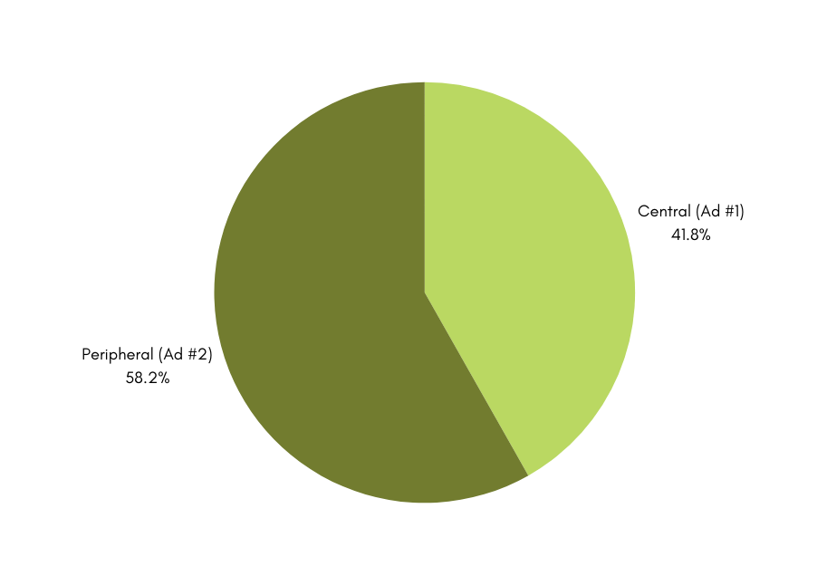
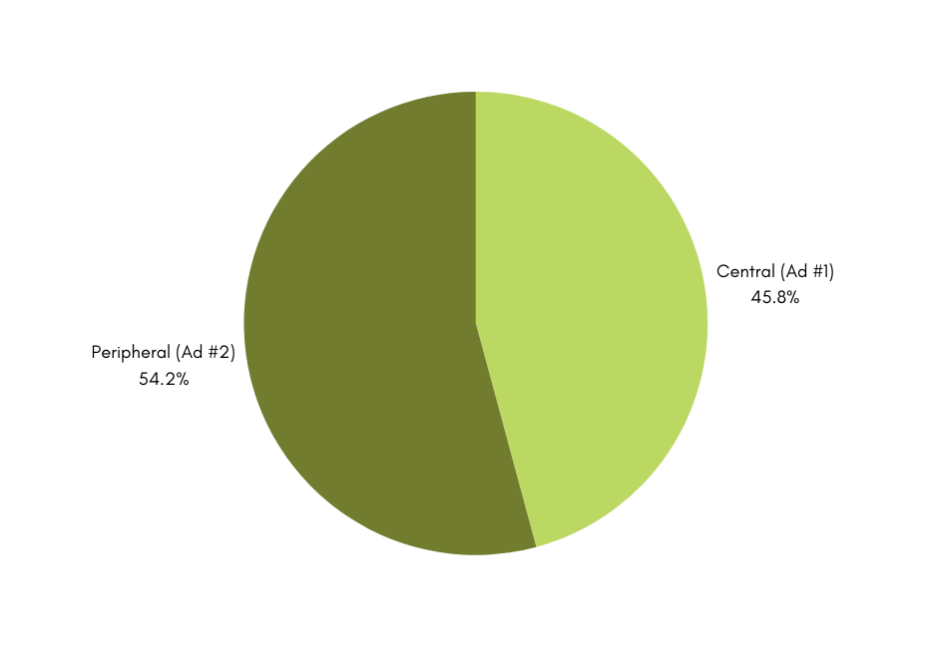
CAMPAIGN RESULTS
(Metrics Evaluation)
Post Interaction
Profile Activity

Slide 11
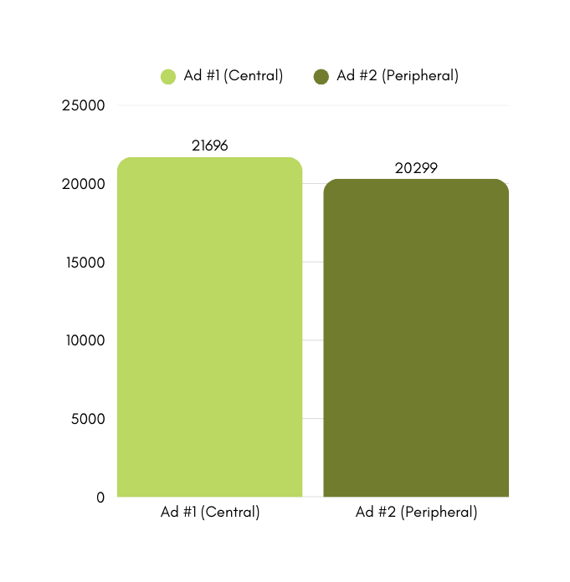
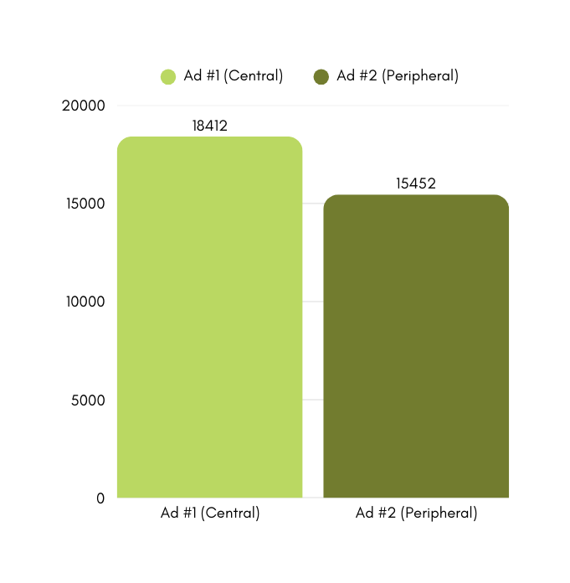
CAMPAIGN RESULTS
(Metrics Evaluation)
Total Views
Reach Overview

Slide 12
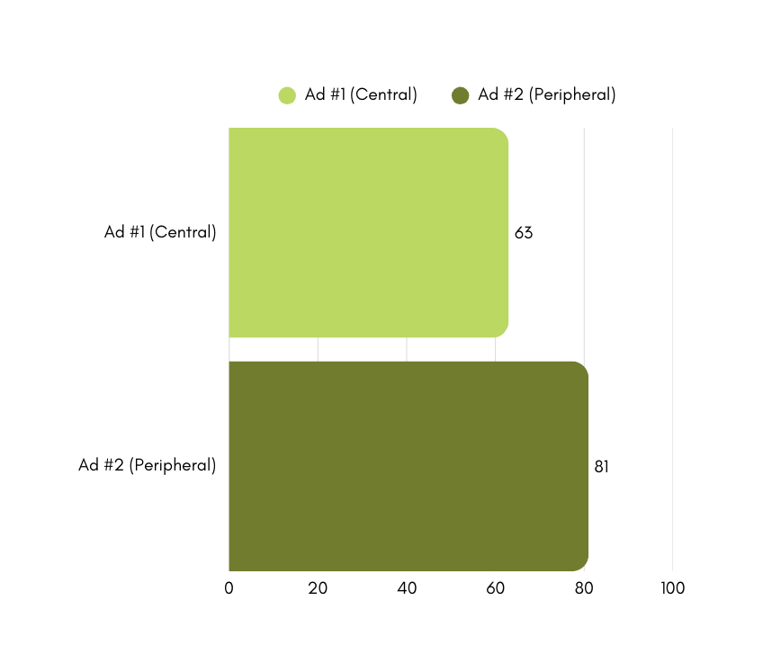
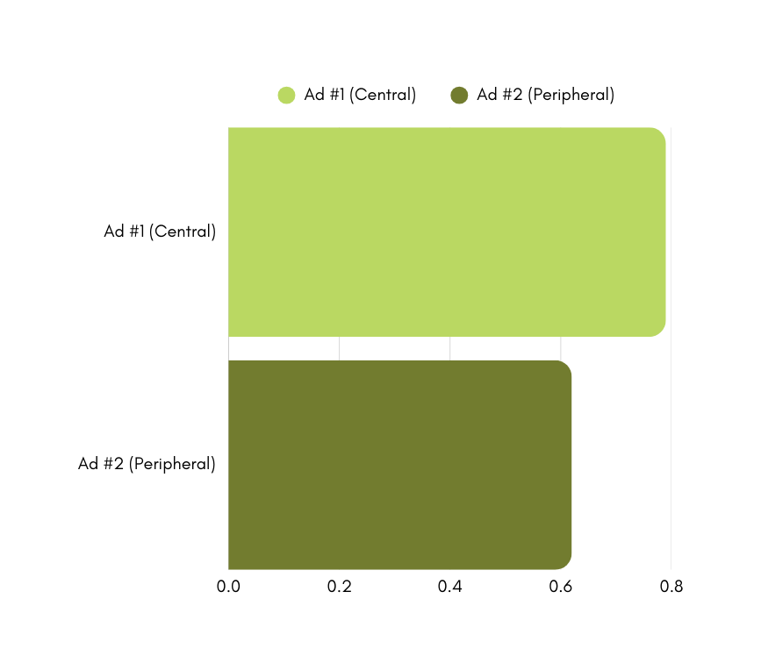
CAMPAIGN RESULTS
(Metrics Evaluation)
Website Visits by Ad Type
Cost Efficiency per Visit

Slide 13
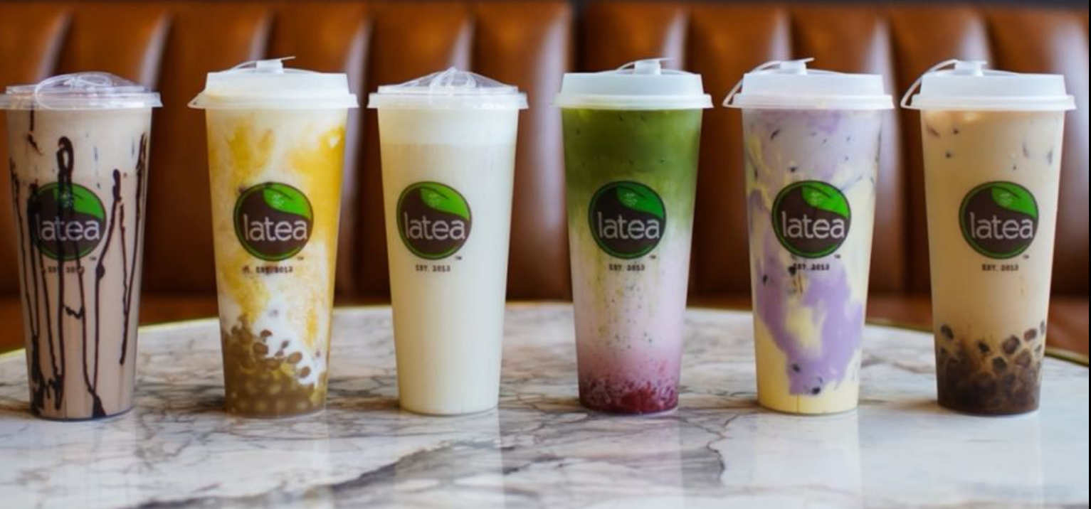
KEY TAKEAWAYS
(FOCUS POINTS)
18%
29%
22%
Higher Engagement
More Website Visits
Lower Cost
Peripheral route ad generated more profile activity.
Social-focused ad drove more traffic to Latea's website.
Cost per website visit was lower for the peripheral route ad.
(206 vs. 174)
(81 vs. 63)
($0.79 vs. $0.62)

Slide 14





STRATEGIC RECOMMENDATIONS
(The Future Pathway)
Emotion
EMOTION
SHAREABILITY
Center ads on connection, warmth, and shared moments.
Use heartfelt taglines and lifestyle imagery.
Shareability
Design content that’s visually appealing and worth saving.
Encourage reposts and highlight user-generated content.
FUTURE
RECOMMENDATIONS
Platform
Maximize Reels and Stories for high engagement.
Use trending audio and short-form narratives.
BALANCE
PLATFORM
Reach
Use inclusive visuals to connect with diverse audiences.
Test across regions to identify top-performing locations.
Balance
Blend emotional appeal with soft product prompts.
Show customization subtly through engaging visuals.
REACH

Slide 15
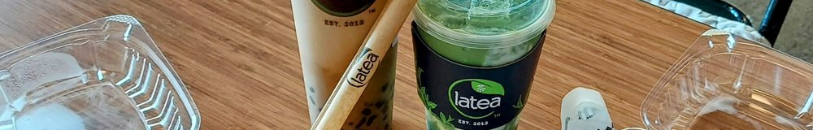
THANK YOU
Questions?

